Slide 1

Performance Analysis of Data Mining Techniques
For Heart Disease Prediction
Presented by:
Mounika Jaggavarapu(16335944)
Lokeshbabu Marella(16336593)
Rama Mohan Reddy Male(16335679)
Sai Nikhil Vankayalapati(16337492)
Guided by:
Prof. Syed Jawad Hussain Shah

Slide 2
Abstract:
In most countries there is a lack of cardiovascular expertise and a significant rate of incorrectly diagnosed cases.
This could be addressed by developing accurate and efficient early-stage heart disease prediction by analytical support of clinical decision-making with digital patient records.
This study is aimed to identify machine learning classifiers with the highest accuracy for such diagnostic purposes.
Several supervised machine-learning algorithms were applied and compared for performance and accuracy in heart disease prediction like Logistic Regression, KNN, DT, RF.
Feature importance scores for each feature were estimated for all applied algorithms.
Finally, we found that a relatively simple supervised machine learning algorithm can be used to make heart disease predictions with very high accuracy and excellent potential utility. Most importantly we focused on getting more accurate Sensitivity for every classifier.

Slide 3
Problem Statement:
Due to high rate of cardio vascular diseases occurring these days early diagnosis of disease could help a person lead happy life so predict whether a person can have heart disease or not based on the parameters given.

Slide 4
Introduction:
Cardiovascular Diseases(CVD) are the number one cause of deaths worldwide.
Early-stage detection of CVD minimizes the cost of treatment and reduces the mortality rate.
Data Mining techniques are playing key role in the clinical research and medical field.
CVD occurs due to many reasons like high cholesterol, high blood pressure, high blood sugar etc.
In this paper we compare different data mining techniques to predict heart disease based on different performance measures on a dataset containing different attributes which have impact on CVD.
Based on performance, best algorithm is chosen for predicting heart disease.

Slide 5
Objective:
Understand various parameters that effect the cardio vascular health of a person.
Compare various Classifiers and predict whether a person can have cardio vascular disease by the best performing model.
Also know about the factors that have great impact on cardiovascular health.

Slide 6
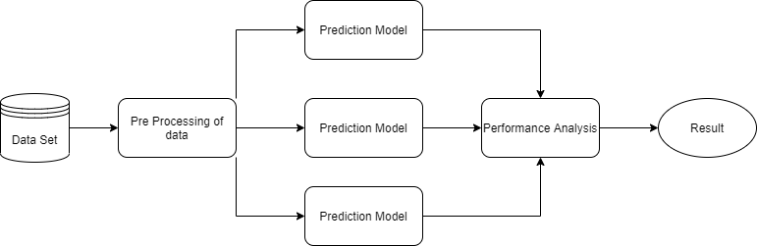
Conceptual Diagram:

Slide 7
Data Set:
Description : This data set dates from 1988 and consists of four databases: Cleveland, Hungary, Switzerland, and Long Beach V. It contains 76 attributes, including the predicted attribute, but all published experiments refer to using a subset of 14 of them. The "target" field refers to the presence of heart disease in the patient. It is integer valued 0 = no disease and 1 = disease.
Link : https://www.kaggle.com/johnsmith88/heart-disease-dataset
Type : csv

Slide 8
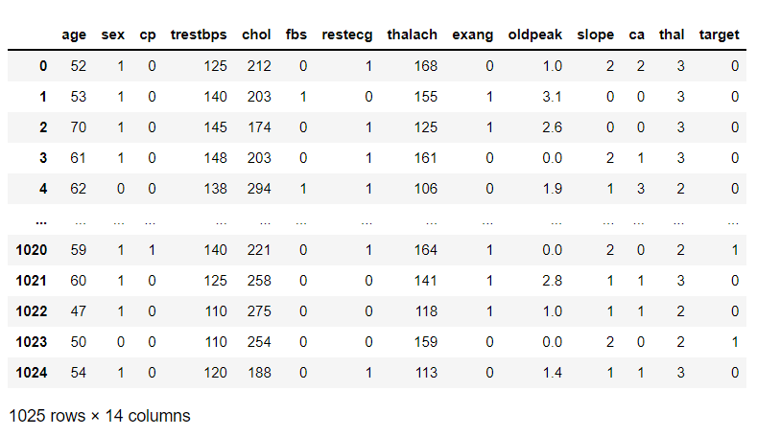
Sample data set:

Slide 9
Modules:
1. Data Pre-processing
Outlier Removal(IQR Filter)
Balancing Data(SMOTE)
2. Models
Logistic Regression
K Neighbours
Decision Tree
Random Forest
3. Feature Importance Scores

Slide 10
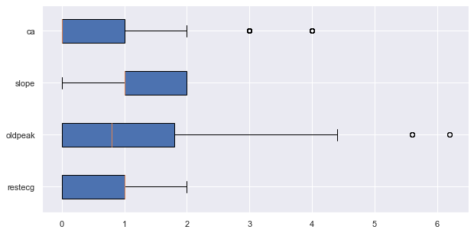
Module: Data Pre-processing
Boxplot before Outlier Removal :

Slide 11
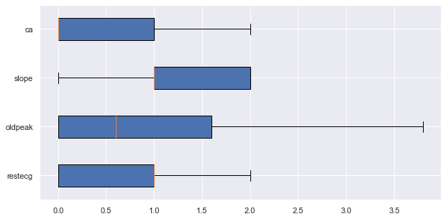
Boxplot After Outlier Removal :

Slide 12
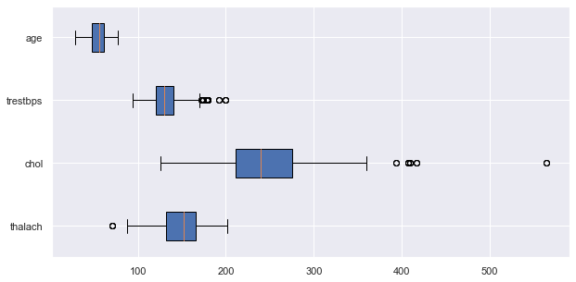
Boxplot before Outlier Removal :

Slide 13
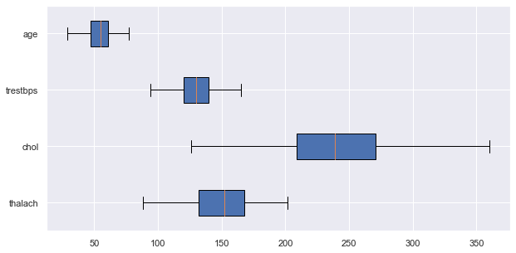
Boxplot After Outlier Removal :

Slide 14
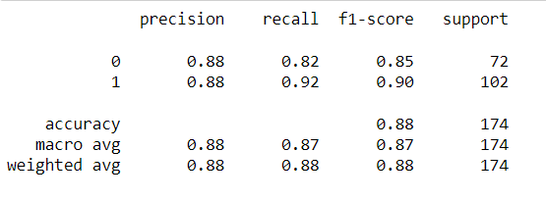
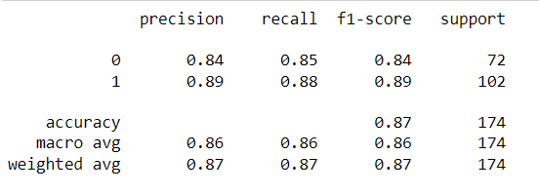
Module: Data Pre-processing
Before Applying SMOTE
After Applying SMOTE
We can see a slight increase in recall of minority class(‘0’).
It is due to oversampling of minority class data.

Slide 15
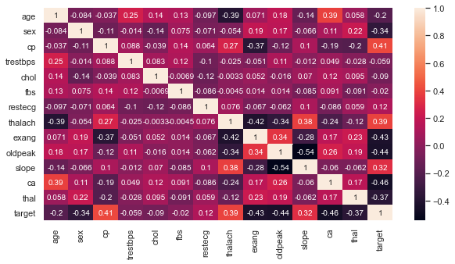
Heat Map for corelation Matrix :

Slide 16
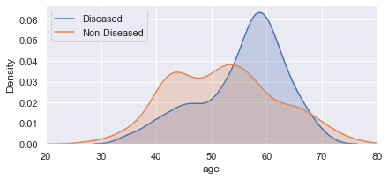
Density plot of Age :

Slide 17
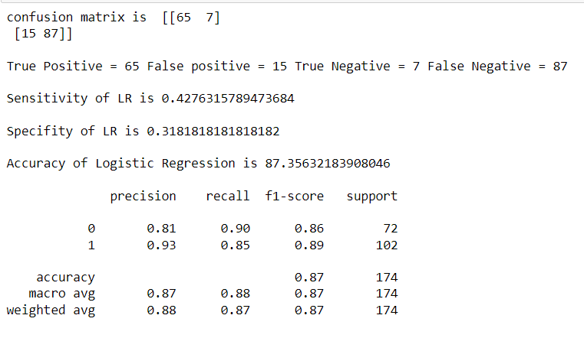
1. Logistic Regression :
Confusion Matrix & Classification Report :
17

Slide 18
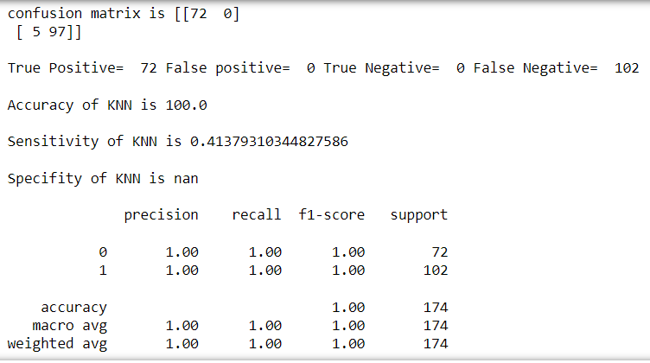
2. KN Neighbours Classifier :
Confusion Matrix & Classification Report :

Slide 19
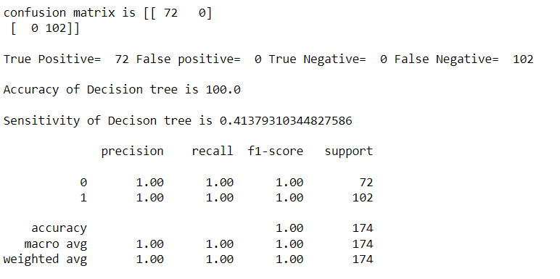
3. Decision Tree Classifier :
Confusion Matrix & Classification Report :
19

Slide 20
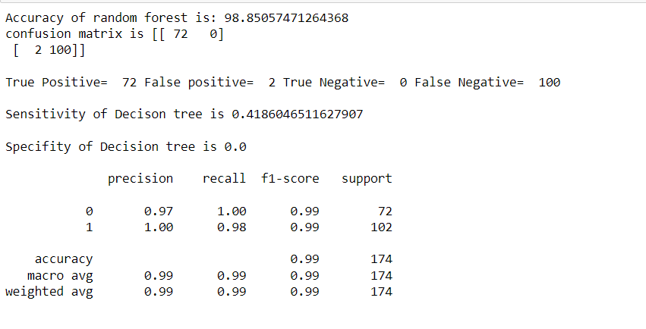
4. Random Forest Classifier :
Confusion Matrix & Classification Report :
20
20

Slide 21
Evaluation Metrics :
Precision : The number of true positives divided by the total number of positive predictions.
Precision=TP / (TP + FP)
Recall : The number of true positives divided by the total number of true positives and true negatives.
Recall=TP / (TP + FN)
F-Measure: provides a single score that balances both the concerns of precision and recall in harmonic mean.
F-Measure=2 * precision * recall / (precision + recall)
Kappa: It is used to measure the level of agreement between two raters who each classify items into mutually exclusive categories.
Kappa= PrPr (a) – Pr(e) / (1-Pr(e))
.

Slide 22
MCC: It is a more reliable statistical rate which produce a high score only if the prediction obtained good results in all of the prediction obtained good results in all of the four confusion matrix categories(TP,FN,TN,FP),proportionally both to the size of positive elements and the size of negative elements in the dataset.
MCC=TP * TN – FP * FN / √ (TP +FP) * (TP + FN) * (TN + FP) * (TN + FN)
Sensitivity: The ability of a test to correctly identify patients with a disease.
Sensitivity=TP / ( TP + FN )
Specificity: The ability of a test to correctly identify people without the disease.
Specificity= TN / (TN + FP)

Slide 23
Evaluation Metrics :
Classifier | Accuracy | Sensitivity | Specificity | Precision | Recall | F-Measure | Kappa | MCC
LR | 87.36 | 0.82 | 0.91 | 0.87 | 0.88 | 0.87 | 0.742 | 0.744
KNN | 86.7 | 0.79 | 0.93 | 0.86 | 0.88 | 0.87 | 0.73 | 0.73
DT | 96.5 | 0.92 | 1 | 0.97 | 0.97 | 0.97 | 0.92 | 0.93
RF | 97 | 0.96 | 1 | 0.96 | 1 | 0.98 | 0.95 | 0.96

Slide 24
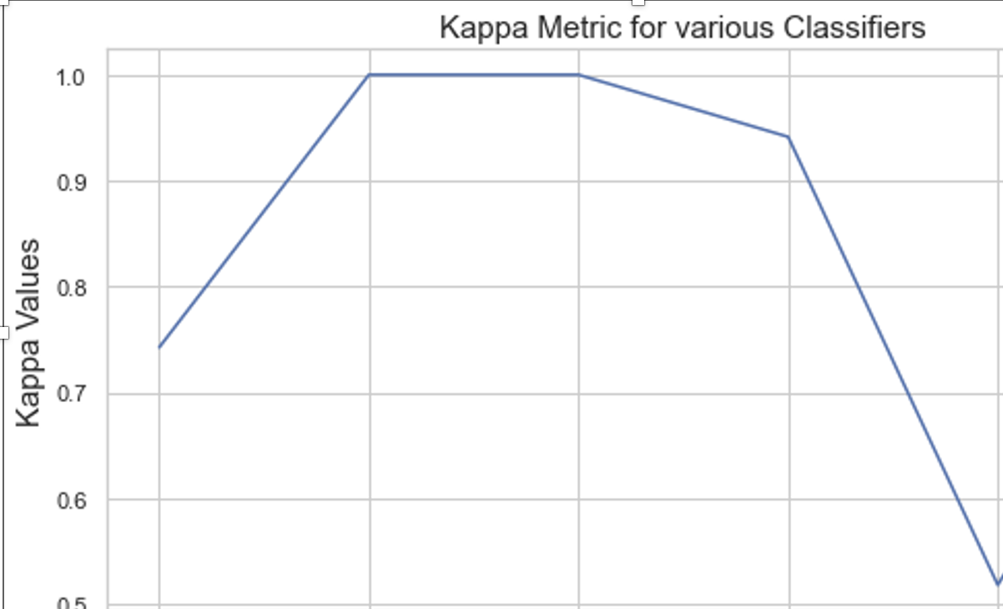
Graph Visualisation – Kappa Values :

Slide 25
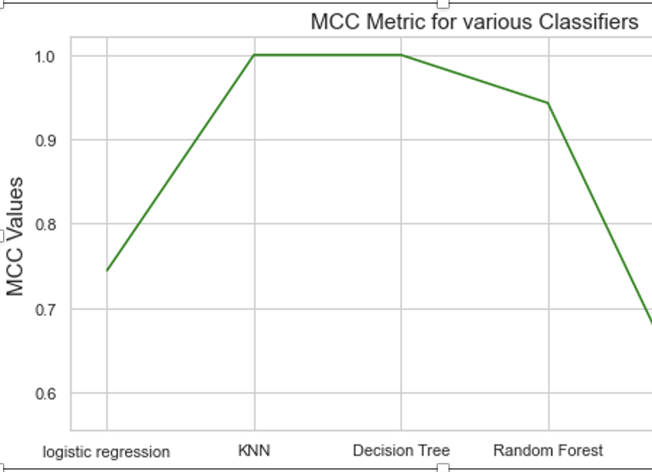
Graph Visualisation – MCC Values :

Slide 26
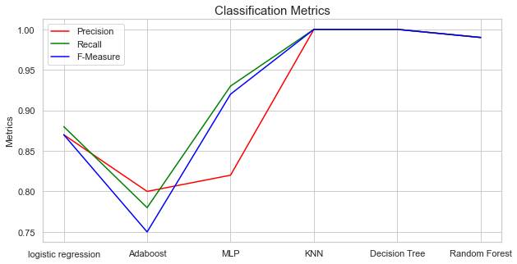
Graph Visualisation – Classification Metrics :

Slide 27
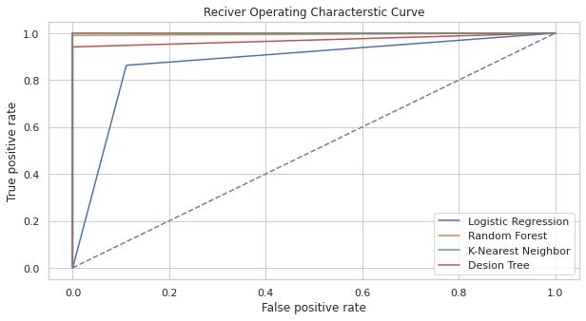
ROC_CURVE Analysis:

Slide 28
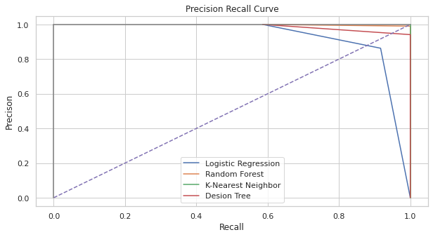
Precision vs Recall curve :
28

Slide 29
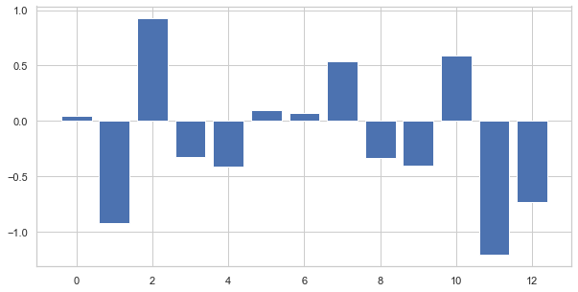
# Feature Importance Score:
Logistic Regression :

Slide 30
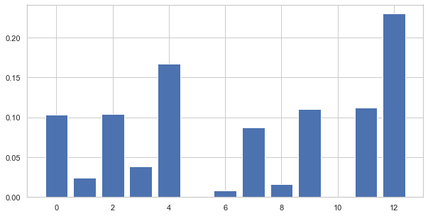
# Feature Importance Score:
Decision Tree Classifier :
30

Slide 31
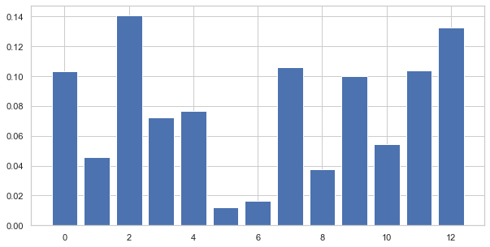
# Feature Importance Score:
Random forest Classifier :
31

Slide 32
Consolidated Feature Importance Scores:
Feature | LR | DT | RF
Age | 0.044 | 0.102 | 0.103
Sex | -0.921 | 0.024 | 0.045
Cp | 0.929 | 0.104 | 0.140
Trestbps | -0.328 | 0.038 | 0.072
Chol | -0.408 | 0.167 | 0.076
Fb | 0.099 | 0.000 | 0.012
restecg | 0.075 | 0.007 | 0.016
Thalach | 0.540 | 0.087 | 0.105
Exang | -0.336 | 0.016 | 0.037
Oldpeak | -0.401 | 0.109 | 0.099
slope | 0.589 | 0.000 | 0.054
Ca | -1.208 | 0.112 | 0.103
thal | -0.733 | 0.229 | 0.132

Slide 33
Conclusion:
From the Evaluation results we can see that KNN algorithm and Random Forest algorithm gave good performance compared to others followed by Decision Tree algorithm.
Also, Features like cp(Chest Pain), Thalach(Max Heartrate achieved), Age have great impact based on feature importance scores table and they rank top 3 when compared to others.

Slide 34
THANK YOU

